Slide 1

Project #1
Exploring the Relationship
Between 2 Datasets:
Airbnb & Starbucks

Slide 2
MC Squared – Class Project #1
The MC Square Team
Project Overview
Data Selection, Collection & Cleanup
Approach & Findings
Challenges & Lessons Learned

Slide 3

Matt Dipinto
Project Manager
Git Master
Data Analyst
When Matt’s not sharing links to the class on slack, you can find him sneaking Belle into Christmas Parties.

Slide 4

Cindy Zhou
Developer
Mapping Queen
Data Specialist
When Cindy’s not fast tracking through class assignments, she’s spending time with friends at Cirque Soleil.

Slide 5

Christine Kanouff
Content Creator
Visual Effects
Editor
When Christine’s not prompting ChatGPT for homework help, she’s breaking up street fights.

Slide 6

Project Overview
1
Explore a Compelling Topic:
This Ruled out Sports and Financial Datasets
Things We Had in Common? Travel & Coffee
Select Datasets to Combine & Compare:
Robust Dataset for Airbnb
Limited Starbucks (breadth) but Hitched Our Wagon to “Atlas”
Also Wanted to Look at Multiple Markets
2

Slide 7
Project Overview
3
Build Sound Research Objectives:
Analyze Airbnb Market Trends and Growth
How has it grown and what can we forecast?
Examine the Correlation of Airbnb and Starbucks Locations
Is there a relationship between Starbucks and Airbnb locations?
Any impact on perceived quality or cost of an Airbnb stay?
Compare Markets
What similarities/differences between Denver & London
Can the Data Predict Successful Airbnb Locations?

Slide 8
Project Overview
4
Use Strategic Methodology:
Create & Agree to Plan
Control Scope Creep
Assign the Right Person to the Right Task
Keep it Simple and Test the Denver Market First

Slide 9

Project Overview
5
But, we also asked our team: Is this a real-life example?
Yes, Here’s Our Client:
Semi-retired actor who wants to add a reliable income stream to his already-healthy portfolio of investments.
Is an Airbnb a good long-term investment for Anthony? And if so, in what market?

Slide 10


Data Selection, Collection & Cleanup
Both Starbucks and Airbnb had datasets that were easy to access. However, Starbucks financial data was not readily available.
Eliminated Columns (75) Down to 30 Total
Filled NA Data & Replace Null With -1
Cleaned Price Column and Standardized as Float
Converted Bathroom to Number
Removed Outliers (over $2,000)
Converted Dates to Datetime
Pulled in Airbnb Reviews Data
Calculated how often ”Starbucks” was mentioned in review
Selected Columns to Keep
Filter for Location
Postal Code Standardized to Five Digits
Found Average Latitude and Longitude
Calculated within 25 Mile Radius of all Starbucks Locations

Slide 11
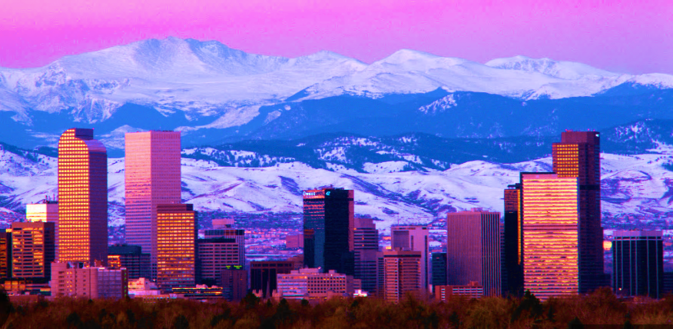

Data Selection, Collection & Cleanup
Final London Dataset:
256 Starbucks
88,701 Airbnb
Final Denver Dataset:
303 Starbucks (Yes, 303)
5,367 Airbnb

Slide 12
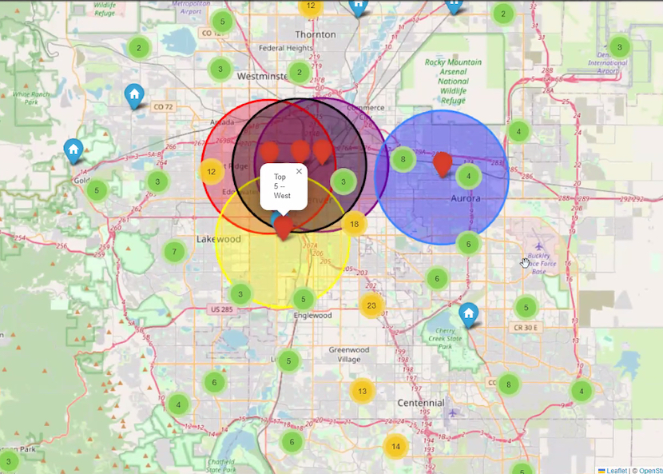
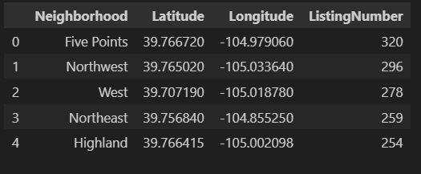
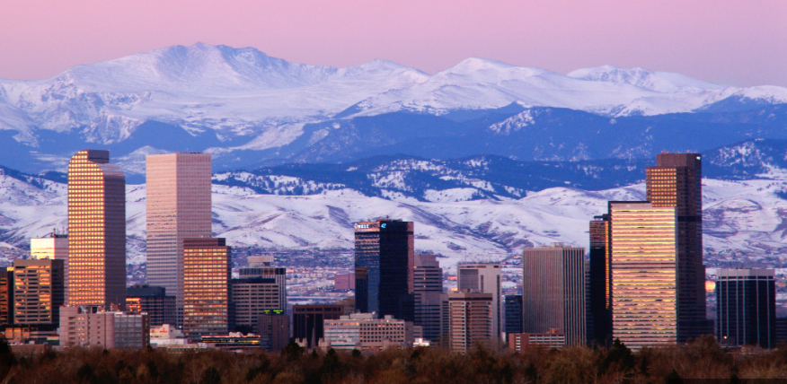
Approach & Findings
Very Import First Look – Denver Data Mapping
Top 5 Districts:
Airbnb uses the Top 5 ”Districts” to rate neighborhoods. (Hunger Games here we come.)

Slide 13
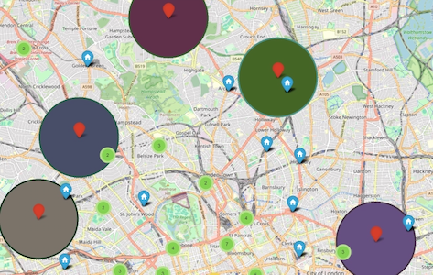
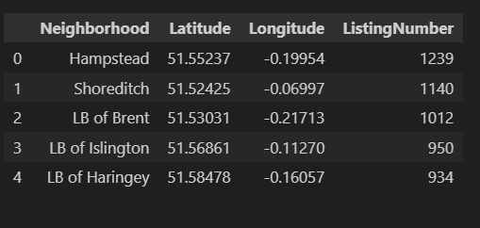

Approach & Finding
Denver Complete, Now London
This Mapping Was an Important Step as it Gave us A Sense of What We Could Actually Analyze.

Slide 14
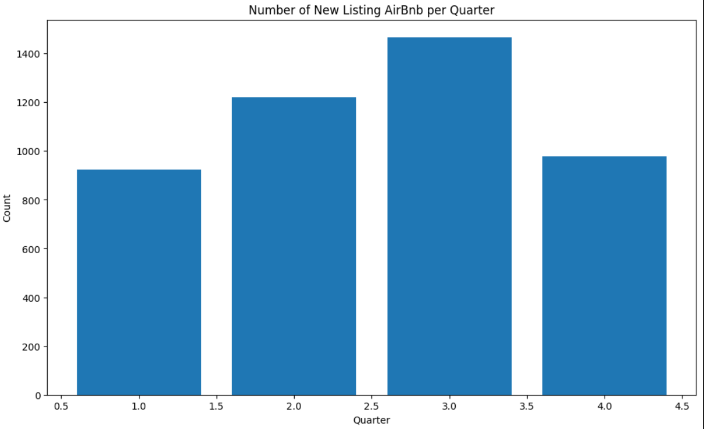
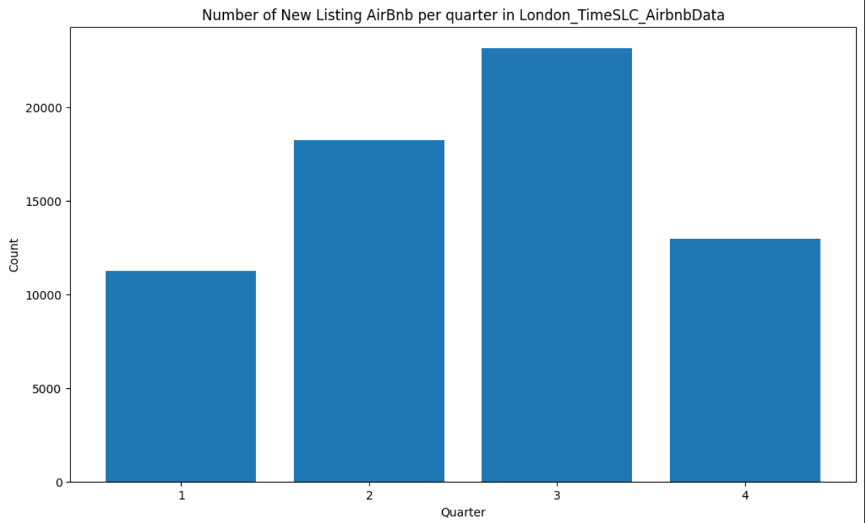
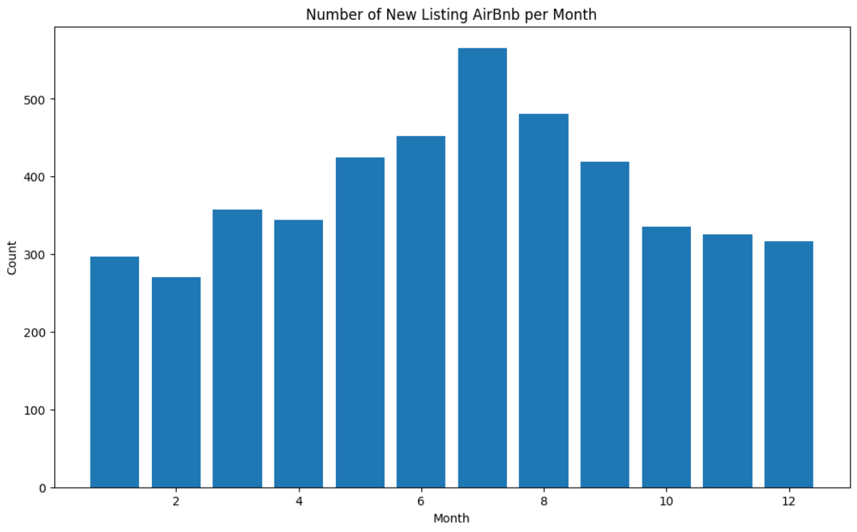
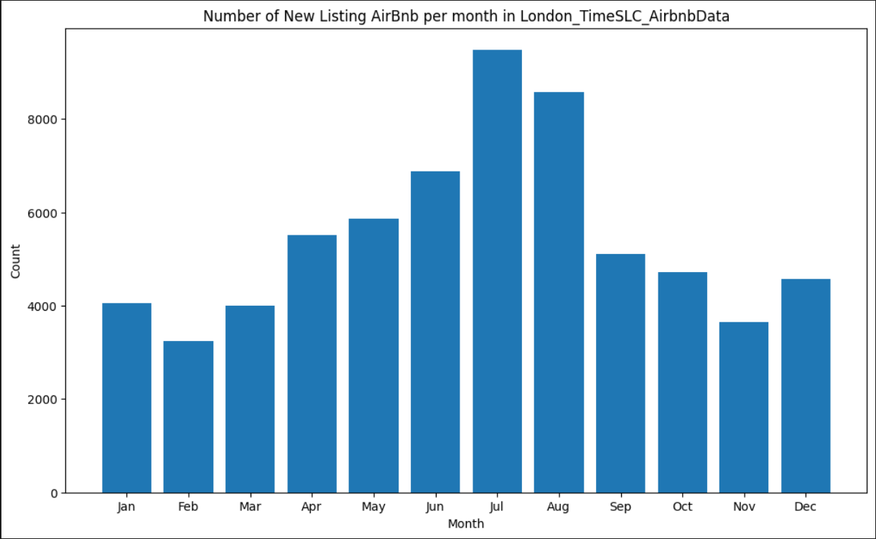
Approach & Findings
When is the Best Time to Enter the Airbnb Market?
Denver Market
London Market
Denver Market
London Market
Growth Since 2008 in the 3rd Quarter/Summer Months

Slide 15
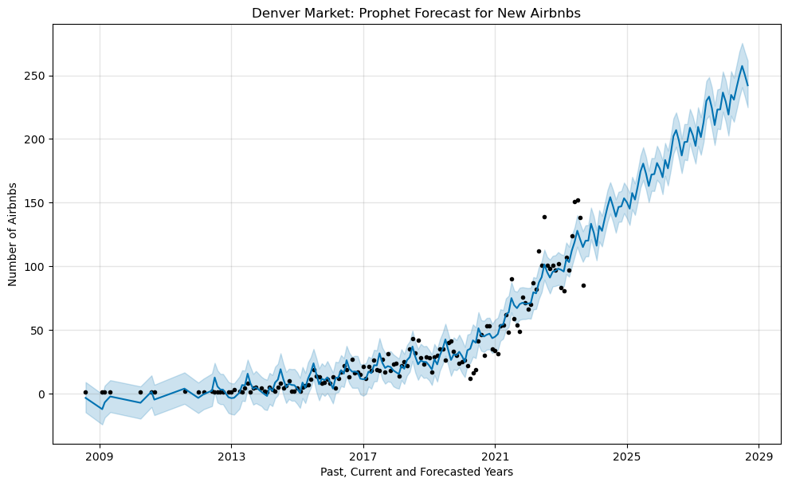
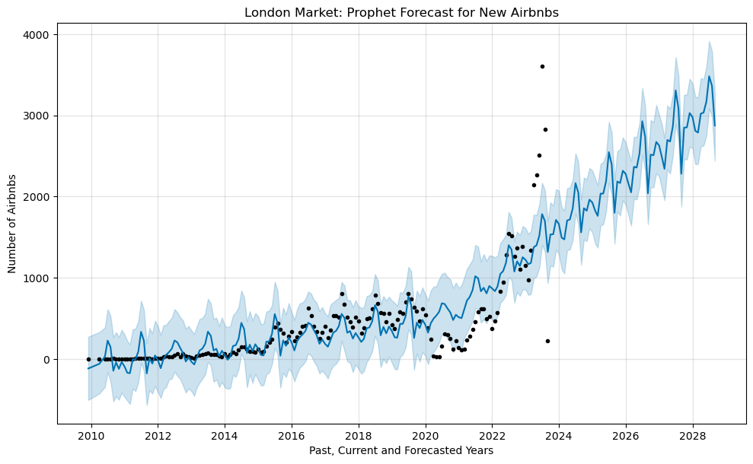
Approach & Findings
Growth Since 2008 and Forecast Through 2029?
Denver Market
London Market
The Forecast For Airbnb Looks Good Through 2028

Slide 16
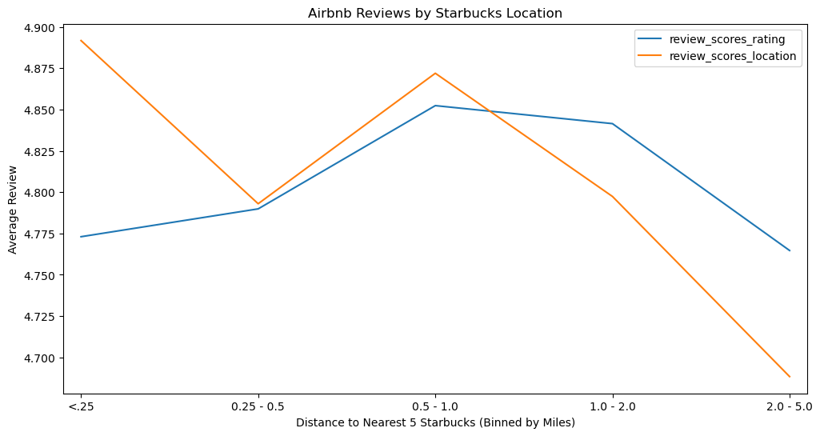
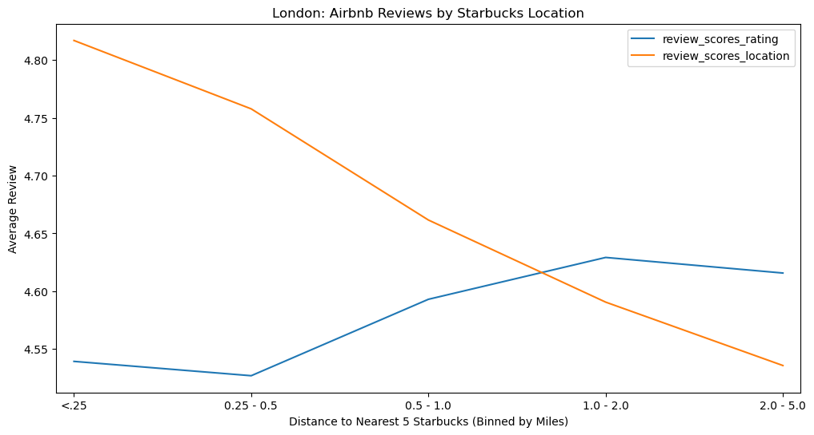
Approach & Findings
How Do Top Airbnb Reviews Relate to Starbucks Proximity?
Denver Market
London Market
The Denver Market Seems to Suggest that There
is a Sweet Spot for Good Reviews

Slide 17
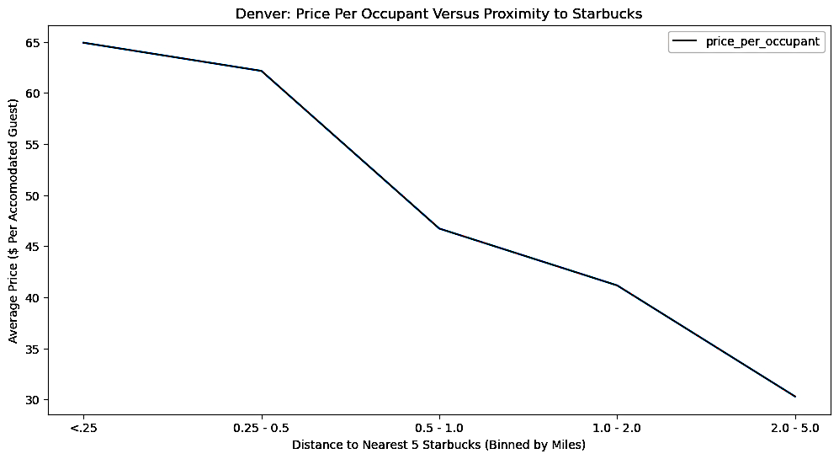
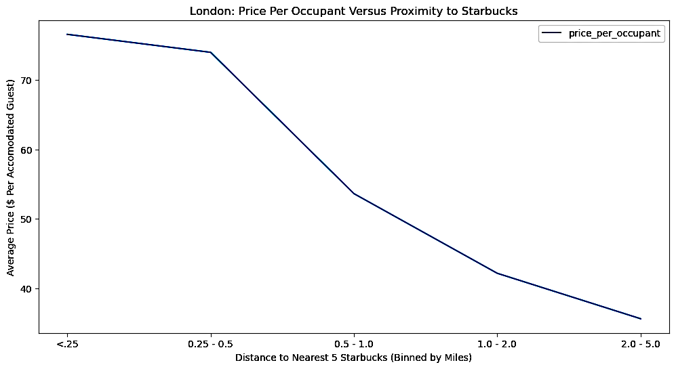
Approach & Findings
Is There a Relationship Between Airbnb Cost & Starbucks Proximity?
Denver Market
London Market
Yes, the more expensive the stay, the more Starbucks locations are within walking distance (approximately 5 locations within ¼ - ½ a mile).

Slide 18
Recommendations
Yes, Airbnb is still a good addition to your portfolio.
But, before you purchase a property, we recommend additional data analysis:
Property costs versus sellable price per night.
Population density data & tourist data.
However, if you’re ready to take the plunge, we did do heat maps on both locations to look for opportunities, looking at areas in Denver and London where there were a lower number of Airbnb with proximity to Starbucks.

Slide 19

Lessons Learned
Teamwork & Data Analysis
Keep it small and manageable.
Everything will take longer than you anticipate.
Things will go wrong - ask for help.
In the end, leverage the skills in your group.
Make sure everyone understands “how you got there”.

Slide 20
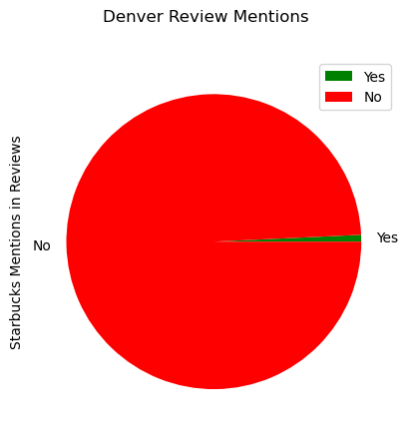
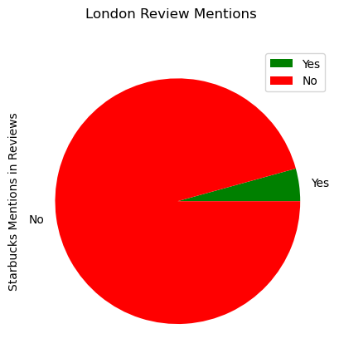
Questions?
At the End of the Day, We have 2 Questions:
Don’t you love our pie chart?
How much do Airbnb Guests care about Starbucks?
Denver Market
London Market
What Questions Do You Have for Us?

Slide 21
Resources & Articles
https://www.networkworld.com/article/935670/big-data-secrets-from-airbnb-starbucks-and-sonic.html
https://nycdatascience.com/blog/student-works/data-analysis-on-starbucks-location/
research & analysis by MC Squared

Slide 22

Use at your own risk!
THE GRAVEYARD

Slide 23
Title of Slide – Option 1

Slide 24
Title of Slide – Option 2

Slide 25
Christine’s Favorite Quotes
Know Your Dataset & Machine Capabilities:
”Why did the other dataset download so fast?”
”Do you think my MAC will blow up?”
”Feather file, yeah, try that. Or maybe Zip?”
”Okay. Okay. I think this is going to work? Wait. Why is my machine now just spinning?”

Slide 26

Hired MCSquared to Determine:
Is an Airbnb…a good long-term investment? And if so…in what market?
Anthony Taylor

Slide 27
Some Background on Airbnb
Published by Statista Research Department, Apr 21, 2023
Airbnb has become a global phenomenon since its founding in 2008. As of April 2023, Airbnb's market capitalization valued at 73.34 billion U.S. dollars, up from 54.13 billion U.S. dollars the previous year. Over the past four years, the company's market capitalization peaked in 2021 at over 100 billion U.S. dollars.
Simple Findings = Incredible Impact
Riley Newman, head of analytics and data science at Airbnb, ran a regression to determine the features of a listing that had the most impact on whether it would get booked, and he unearthed a shockingly simple insight: unappealing looking listings don’t get booked. Appealing ones do.
Taking Action
Airbnb eventually rolled out a tool that allowed hosts to request free professional photo shoots, and in the process, not only did they boost bookings, but they earned a ton of loyalty from the owners.

Slide 28

Why Starbucks Data?
Starbucks built a market-planning and store-development application called Atlas. The best way to think of Atlas is as a Big Data analytics tool layered on top of mapping software. Built on Esri’s ArcGIS (GIS stands for Geographic Information System), Atlas lets Starbucks factor in a range of variables that contribute to the success of existing stores, visualize them on maps, and then seek out similar areas for new locations.

Slide 29
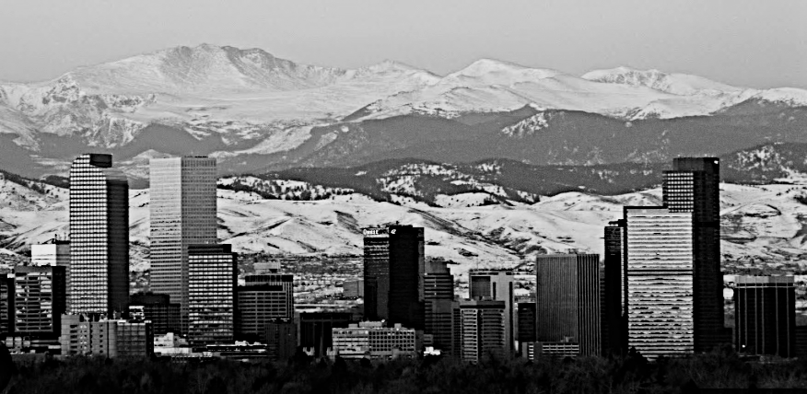
Denver, Colorado
After Cleanup, Final Datasets Included:
303 Denver Starbucks
5,367 Denver Airbnb Sites
In 5 Major Denver Neighborhoods

Slide 30
Data Section, Collection & Cleanup
What Questions Could the Data Help us Answer?
How to Show Results?
Project Overview
?

